Slide 1
SPARK
Transformations and Actions

Slide 2
What is a Transformation?
RDD transformations returns pointer to new RDD and allows you to create dependencies between RDDs.
Each RDD in dependency chain (String of Dependencies) has a function for calculating its data and has a pointer (dependency) to its parent RDD.
Transformations are just manipulations of the data
Each time new RDD is created when we apply any transformation.
Applying transformation built an RDD lineage, It is a logical execution plan i.e., it is Directed Acyclic Graph (DAG) of the entire parent RDDs of RDD.

Slide 3
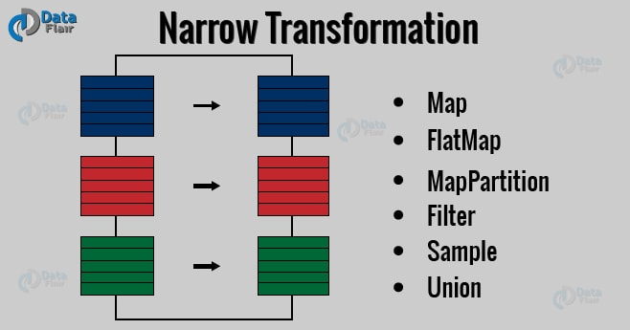
Two Types of Transformations
Narrow transformation – In Narrow transformation, all the elements that are required to compute the records in single partition live in the single partition of parent RDD. A limited subset of partition is used to calculate the result. Narrow transformations are the result of map(), filter().

Slide 4
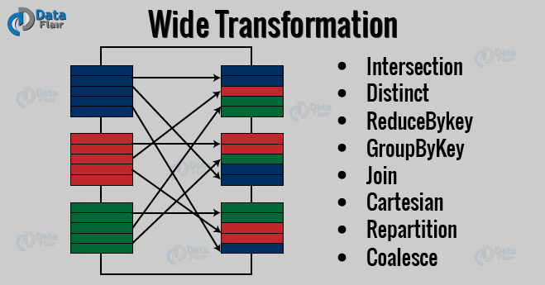
Two Types of Transformations
Wide transformation – In wide transformation, all the elements that are required to compute the records in the single partition may live in many partitions of parent RDD. The partition may live in many partitions of parent RDD. Wide transformations are the result of groupbyKey() and reducebyKey().

Slide 5
map() vs mapPartitions()
mapPartitions() can be used as an alternative to map() & foreach(). mapPartitions() is called once for each Partition unlike map() & foreach()which is called for each element in the RDD.
The main advantage being that, we can do initialization on Per-Partition basis instead of per-element basis(as done by map())
Consider the case of Initializing a database. If we are using map() or foreach(), the number of times we would need to initialize will be equal to the no of elements in RDD. Whereas if we use mapPartitions(), the no of times we would need to initialize would be equal to number of Partitions
We get Iterator as an argument for mapPartition, through which we can iterate through all the elements in a Partition

